Slide 1


Fair Multiple Decision Making Through Soft Interventions
Yaowei Hu¹, Yongkai Wu², Lu Zhang¹, Xintao Wu¹
¹University of Arkansas
²Clemson University
Notes:
In this work, we studied fair multiple decision making through soft interventions.

Slide 2



Fair Decision Making
Admission
Recruiting
Credit
…
How to ensure fairness in algorithmic decision making models is an important task in machine learning.
Notes:
How to achieve fairness is receiving increasing attention in the machine learning fields.

Slide 3
Multiple Decision Making
X₁
X₂
S
Y₁
Y₂
…
Notes:
Most of previous research generally focuses on a single decision model. However, in reality there usually exist two or more decision models and all of which may contain a certain amount of discrimination or unfairness.

Slide 4
Fair Multiple Decision Making
X₁
X₂
S
Y₁
Y₂
Notes:
Ideally we would like to build fair models for all decision making tasks. However, it is difficult even if we know how to build a fair model for each task. This is because the data distribution can change as a consequence of deploying new models.

Slide 5
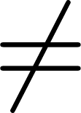
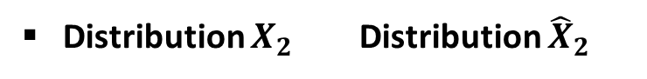
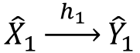
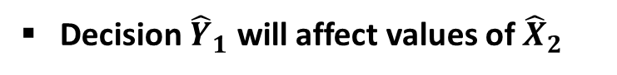
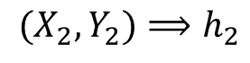
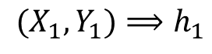
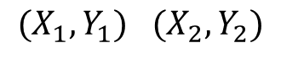
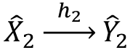
What if we build fair model for each task independently?
$$(X_{1},Y_{1})⟹h_{1}$$
(fair classifier)
$(X_{1},Y_{1})$ $(X_{2},Y_{2})$
$$(X_{2},Y_{2})⟹h_{2}$$
(fair classifier)
Step 1: data collection
Step 2: offline training and evaluation (separately)
Why ?
$${\hat{X}}_{1}\underset{→}{{ h}_{1} }{\hat{Y}}_{1}$$
(fair)
Decision ${\hat{Y}}_{1}$ will affect values of ${\hat{X}}_{2}$
$${\hat{X}}_{2}\underset{→}{{ h}_{2} }{\hat{Y}}_{2}$$
(unfair)
Distribution $X_{2}$ Distribution ${\hat{X}}_{2}$
Step 3: deploy and make decisions on new data
Notes:
Consider an intuitive method which builds the fair model for each task independently. When we deploy these classifiers to make decisions for new data, the predicted $Y_{2}$ may not be as fair as in the training. This is because the predicted $Y_{1}$ will affect new values of $X_{2}$. So the distribution of $X_{2}$ in the new data may not be the same as that in the training data.

Slide 6
Proposed Solution
Core idea: leverage Pearl’s structural causal model (SCM), treat each decision model as a soft intervention and infer the post-intervention distributions to formulate the loss function as well as the fairness constraints.
Notes:
In this work, we propose a method which could learn multiple fair classifiers simultaneously. Our core idea is to leverage Pearl’s structural causal model (SCM), treat each decision model as a soft intervention and infer the post-intervention distributions to formulate the loss function as well as the fairness constraints.

Slide 7
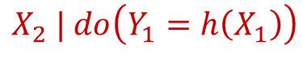
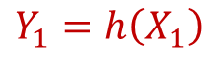
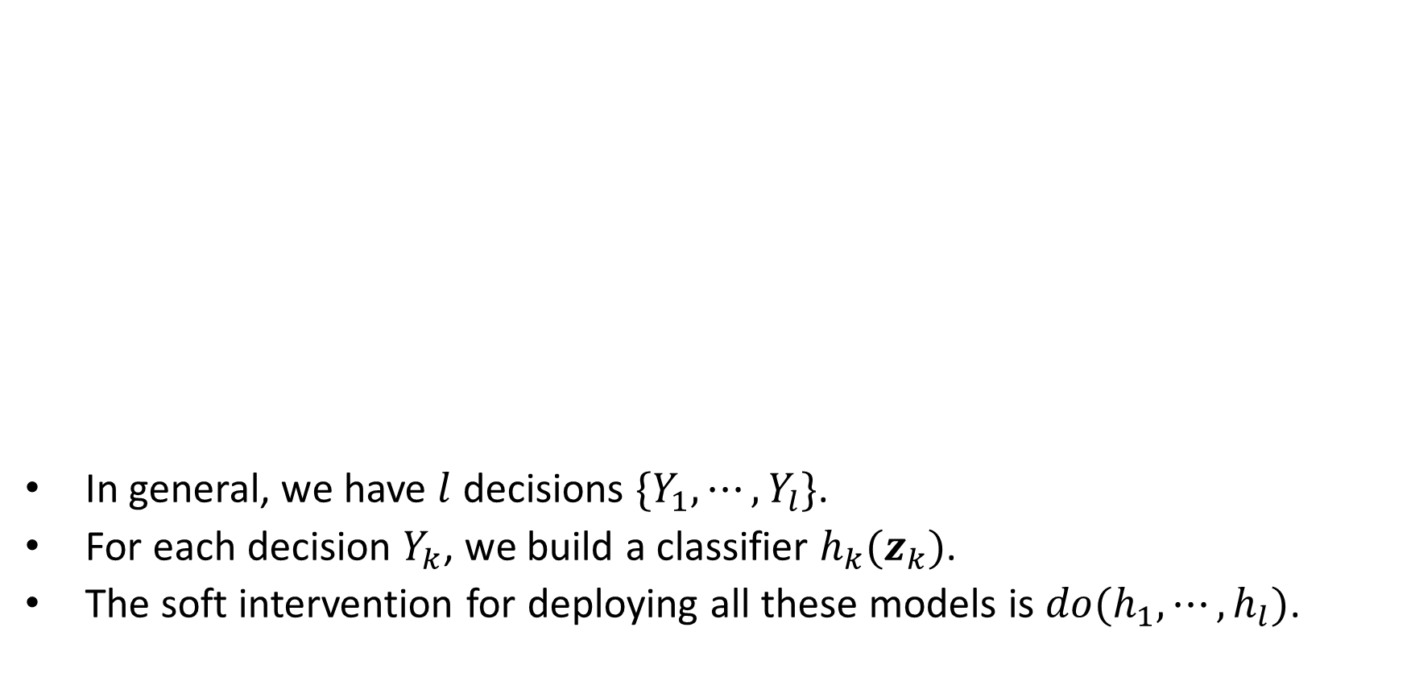
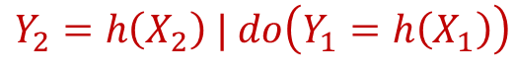
Using Soft Interventions to Simulate Decision Model Deployments
In general, we have $l$ decisions $\{Y_{1},⋯,Y_{l}\}$.
For each decision $Y_{k}$, we build a classifier $h_{k}(z_{k})$.
The soft intervention for deploying all these models is $do(h_{1},⋯,h_{l})$.
X₁
X₂
$$X_{2} | do\left(Y_{1}=h\left(X_{1}\right)\right)$$
S
Y₁
Y₂
$$Y_{2}=h\left(X_{2}\right) | do\left(Y_{1}=h\left(X_{1}\right)\right)$$
$$Y_{1}=h\left(X_{1}\right)$$
Notes:
In this example, we treat any model for predicting $Y_{1}$ as a soft intervention. Its impact on $X_{2}$ can be inferred as a post-intervention distribution, which is then used in the learning of the model for predicting $Y_{2}$. In general, we assume that we have $l$ decisions, and we use soft interventions for modeling the deployment of all models.

Slide 8
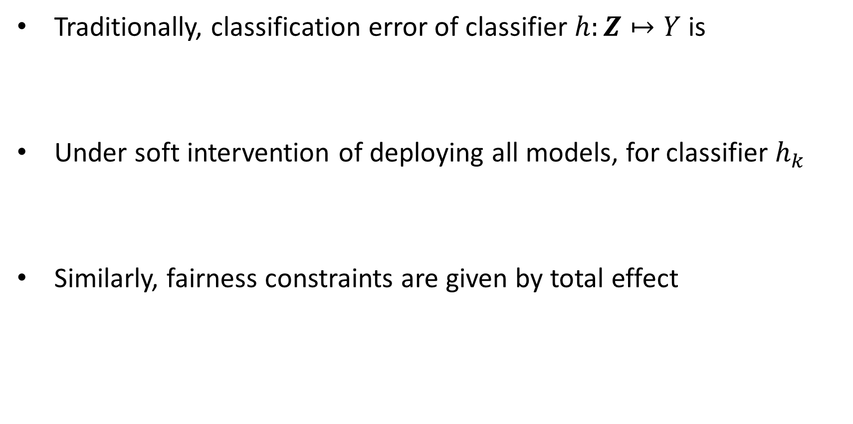
Loss Function and Fair Constraints
Traditionally, classification error of classifier $h:Z↦Y$ is
Under soft intervention of deploying all models, for classifier $h_{k}$
Similarly, fairness constraints are given by total effect
$$R\left(h\right)=𝔼_{Z}\left[P\left(Y=1 | z\right)1_{h\left(z\right)<0}+P\left(Y=0 | z\right)1_{h\left(z\right)≥0}\right]$$
$$R\left(h_{k}\right)=𝔼_{Z_{k}|do(h_{1},⋯,h_{l})}\left[P\left(Y=1 | z_{k}\right)1_{h\left(z_{k}\right)<0}+P\left(Y=0 | z_{k}\right)1_{h\left(z_{k}\right)≥0}\right]$$
$$T\left(h_{k}\right)=P\left(Y=1 | do\left(S=1,h_{1},⋯,h_{l}\right)\right)−P\left(Y=1 | do\left(S=0,h_{1},⋯,h_{l}\right)\right)$$
Notes:
We then derive the loss function and fair constraints under interventions. Traditionally, the classification error of classifier is given by the empirical risk. In our problem, we can similarly define the classification error for each classifier $h_{k}$, but differs in that the expectation is computed under the soft intervention. We also define the fairness constraints as the total causal effect, which is under the soft intervention as well.

Slide 9
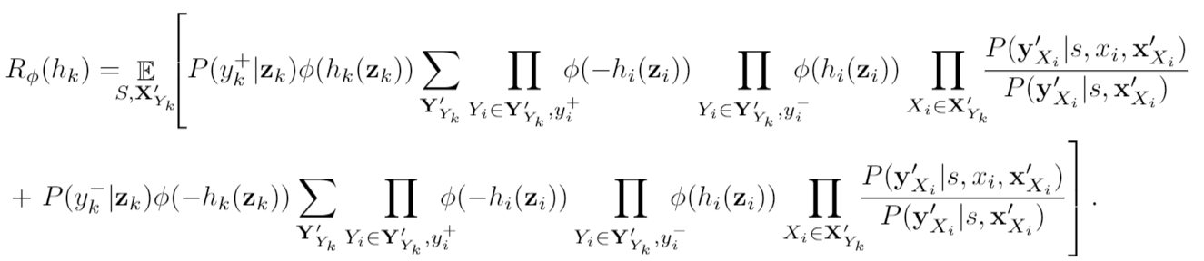
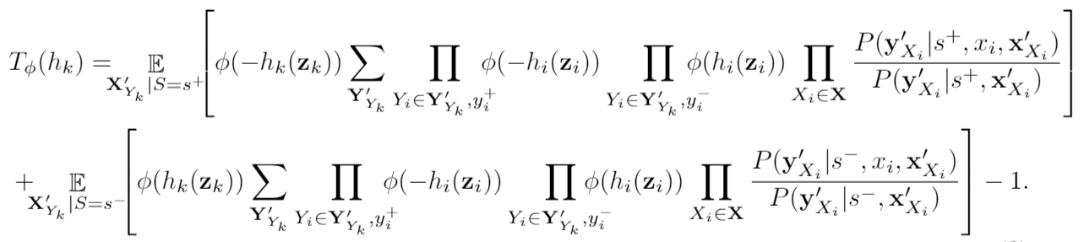
Deriving Loss Function and Fair Constraints with Observed Data
Loss function
Fair constraint
Notes:
By applying the factorization formula and perform several necessary simplifications, we derive the smoothed loss functions and fair constraints which can be directly estimated from the observed data.

Slide 10
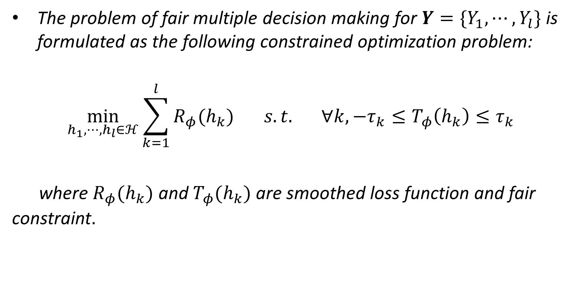
Problem Formulation for Fair Multiple Decision Making
The problem of fair multiple decision making for $Y=\{Y_{1},⋯,Y_{l}\}$ is formulated as the following constrained optimization problem:
$$\min_{h_{1},⋯,h_{l}∈ℋ}{\sum_{k=1}^{l}{R_{φ}(h_{k})}} s.t. ∀k, −τ_{k}≤T_{φ}\left(h_{k}\right)≤τ_{k}$$
where $R_{φ}(h_{k})$ and $T_{φ}(h_{k})$ are smoothed loss function and fair constraint.
Notes:
Based on that, the problem of fair multiple decision making is formulated as a constrained optimization problem.

Slide 11
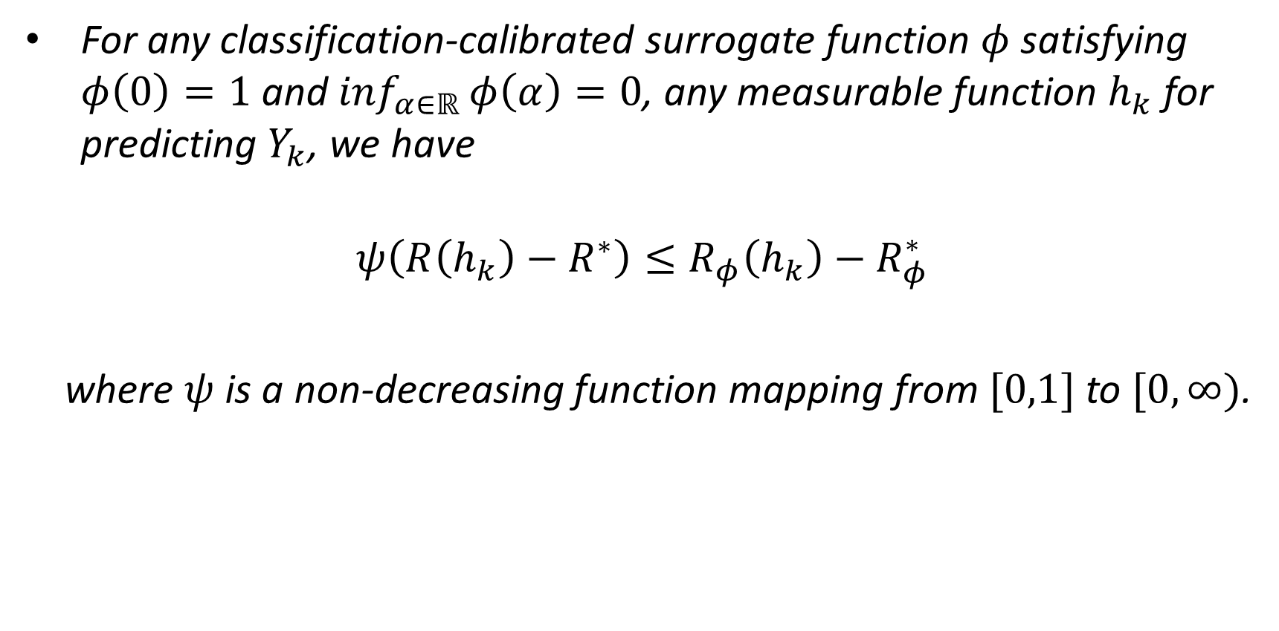
Excess Risk Bound
For any classification-calibrated surrogate function $φ$ satisfying $φ\left(0\right)=1$ and $\inf_{α∈ℝ}{φ\left(α\right)=0}$, any measurable function $h_{k}$ for predicting $Y_{k}$, we have
$$ψ\left(R\left(h_{k}\right)−R^{∗}\right)≤R_{φ}\left(h_{k}\right)−R_{φ}^{∗}$$
where $ψ$ is a non-decreasing function mapping from $[0,1]$ to $[0,∞)$.
Notes:
In order to know whether surrogate errors would accumulate and affect the accuracy of classification, we also analyze the excess risk bound of the loss function. Our theoretical results show that, combining multiple decision models in the optimization would not introduce additional surrogate errors.

Slide 12
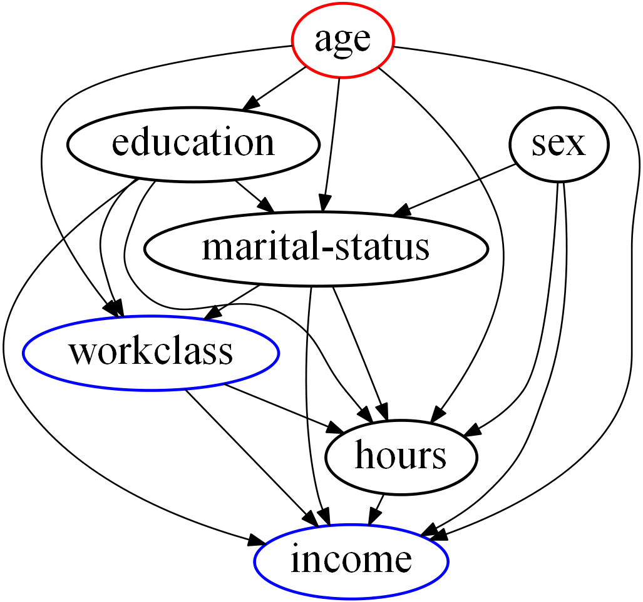
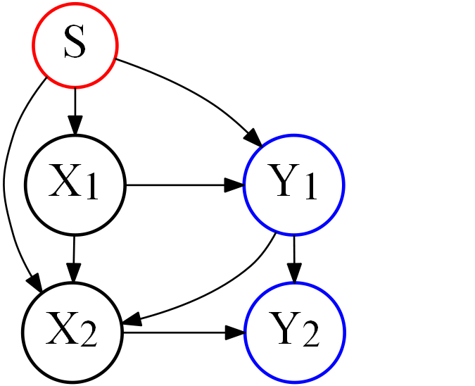
Experiments
Data:
Synthetic data:
Adult data:
Notes:
We conduct experiments on both synthetic data and real-world data,

Slide 13
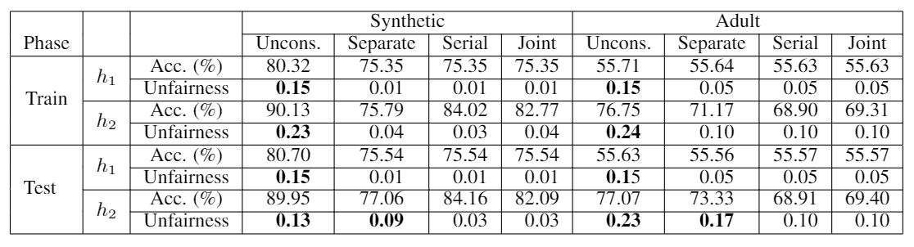
Experiments
Table 1: Accuracy and unfairness from Unconstrained, Separate, Serial and Joint methods
on synthetic and Adult data (bold values indicate violation of fairness).
Notes:
which show the effectiveness of our method.

Slide 14
Conclusions
Proposed an approach that learns multiple fair classifiers from a static training dataset.
Treated the deployment of each classifier as a soft intervention and inferred the distributions after the deployment as post-intervention distributions.
Adopted surrogate functions to smooth the loss function and fair constraints to formulate the fair classification problem as a constrained optimization problem.
Theoretically analyzed excess risk bound.
Conducted experiments on both synthetic and real-world datasets.

Slide 15





Fair Multiple Decision Making Through Soft Interventions
Yaowei Hu
Yongkai Wu
Lu Zhang
Xintao Wu
This work was supported in part by NSF 1646654, 1920920, and 1946391.
Notes:
Thanks for watching.

